Slide 1


QMS Module Flows: APIs & Raw Materials
A practical, end-to-end walkthrough of the Quality Management System for Life Science manufacturers — covering In-Process Quality, Deviation Management, CAPA, Complaints, Recalls, and more.
SUPPLY CHAIN OS · QMS PLATFORM

Slide 2

QMS Module Overview
The QMS platform covers six interconnected modules, each serving a distinct quality function across the product lifecycle.
In-Process Quality
Deviation Management
Real-time monitoring during manufacturing of APIs and raw material batches.
Capture, investigate, and resolve departures from standard operating procedures.
CAPA
Product Complaints
Corrective and preventive actions to eliminate root causes and prevent recurrence.
Systematic intake, investigation, and resolution of customer-reported quality issues.
Recall Management
Supplier Management
Structured process to withdraw non-conforming product from the supply chain.
Qualify, monitor, and audit suppliers of APIs and raw materials.

Slide 3


In-Process Quality
What It Does
Flow: API Example
In-Process Quality (IPQ) monitors critical quality attributes during manufacturing — before the batch is finished — so deviations are caught early and corrected in real time.
01
Batch Initiated
Production Manager opens a batch record for API synthesis (e.g. Ibuprofen bulk).
Each check is tied to a batch record. Results outside specification automatically trigger a deviation record in the system.
02
IPQ Checks Assigned
QA Officer assigns checkpoints: pH, yield, particle size at defined intervals.
03
Results Logged
Operator records results in-system; out-of-spec values are flagged automatically.
04
Review & Release
QA Officer reviews results and approves or escalates to deviation workflow.

Slide 4

Deviation Management
Detect & Report
Classify & Investigate
Close & Review
Contain
API Example
Raw Material Example
A reactor temperature excursion during API crystallisation is flagged. The QA Officer classifies it as Major, investigates the chiller unit failure, and the Production Manager implements a hold on the batch pending investigation.
An incoming shipment of lactose monohydrate fails moisture specification. A deviation is raised, the lot is quarantined, and the supplier is notified — all tracked within the same workflow.

Slide 5
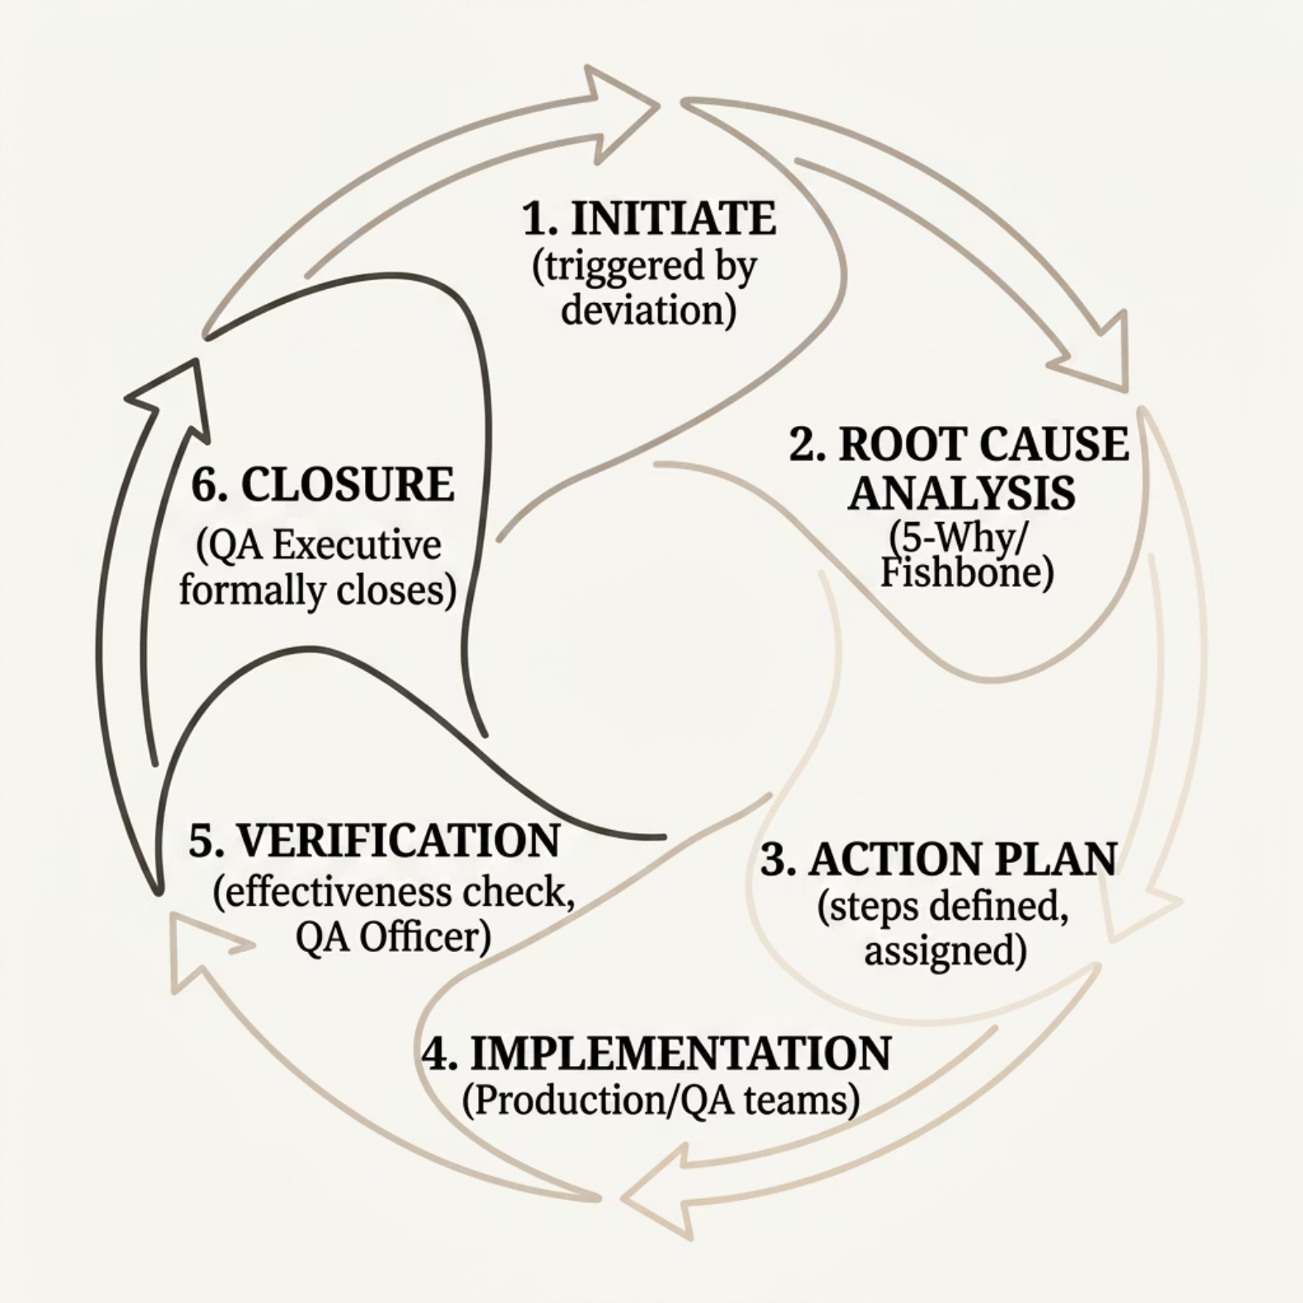


CAPA: Corrective & Preventive Actions
SME Role Breakdown
QA Officer
Production Manager
Leads root cause analysis; drafts corrective actions; verifies effectiveness before closure.
Executes process changes; retrains operators; ensures modified SOPs are followed on the floor.
A CAPA is only closed when the QA Executive confirms the root cause has been eliminated and the issue has not recurred over a defined monitoring period.

Slide 6





Product Complaints
End-to-End Flow
API vs Raw Material Examples
Complaint Received
API Complaint
Customer or distributor reports a quality issue via portal or phone.
A customer reports discolouration in finished tablets. Investigation traces the issue to an API batch with elevated impurity — CAPA raised on synthesis parameters.
Intake & Triage
QA Officer logs the complaint, assigns a category (e.g. contamination, label error, potency), and sets a risk level.
Raw Material Complaint
A packaging supplier reports microcrystalline cellulose causing poor tablet compressibility. QA Officer links complaint to a supplier change event and initiates a re-qualification.
Investigation
Linked to batch records; retained samples tested if available.
Response & CAPA
Written response sent to complainant; CAPA initiated if systemic issue is confirmed.

Slide 7
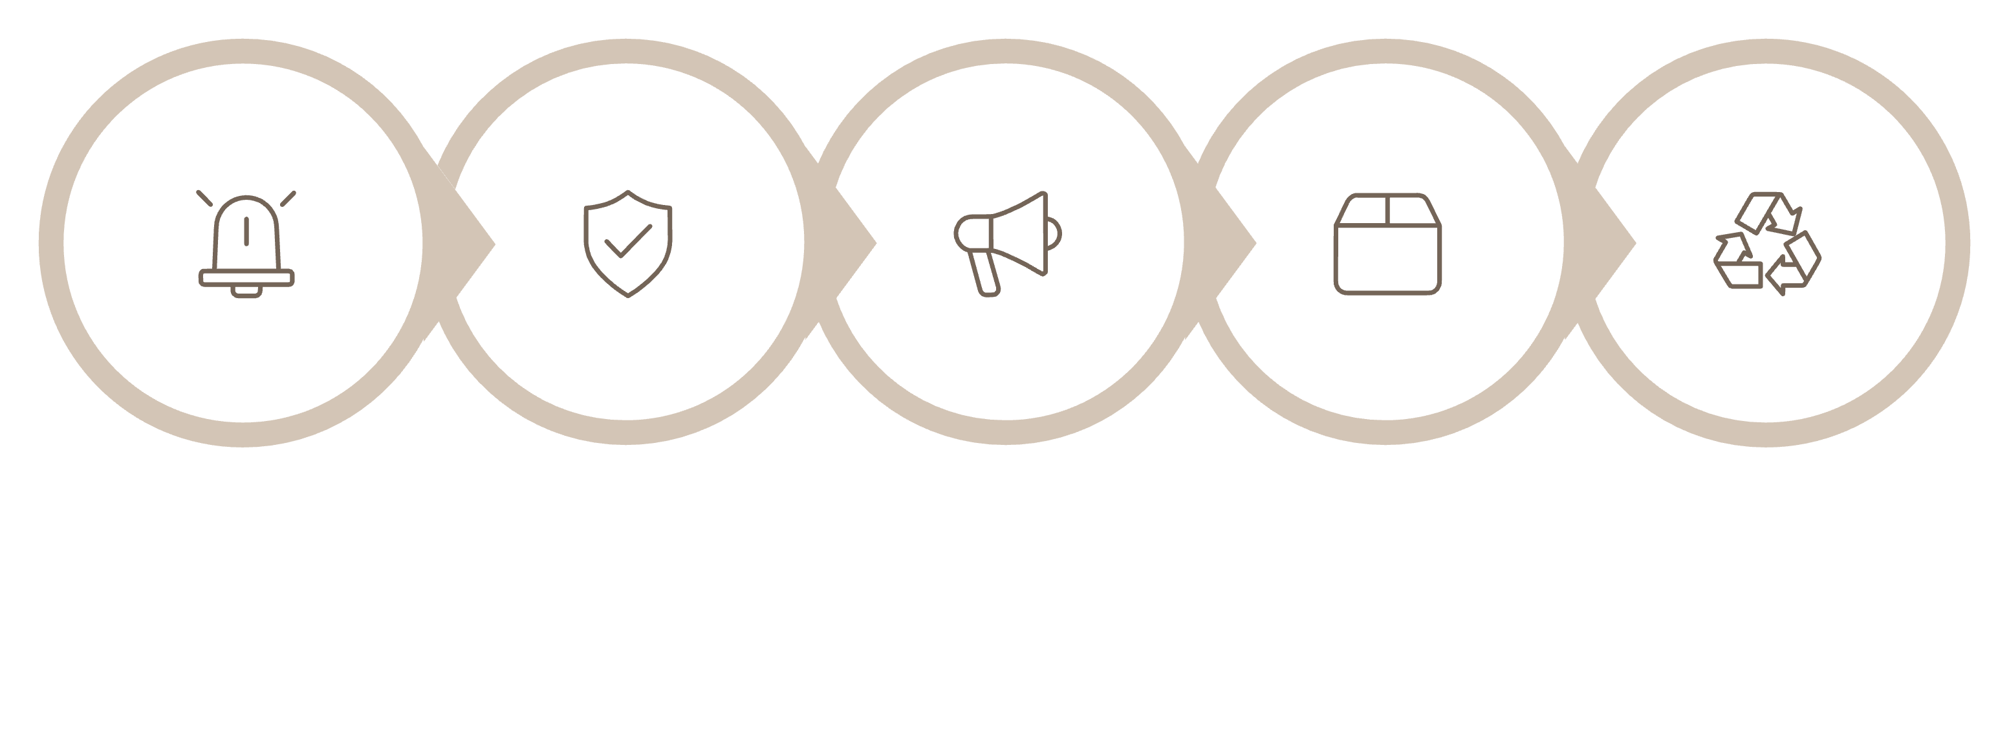
Recall Management
Classification
Disposition & CAPA
Trigger
Notification
Retrieval
API Recall Scenario
Raw Material Recall Scenario
An API batch is found to exceed ICH Q3A impurity thresholds post-release. A Class II recall is issued, affecting three downstream finished-dose manufacturers. The system tracks all distributed quantities and confirms retrieval.
A supplier issues a voluntary recall of a starch excipient due to microbial contamination. The QMS flags all internal batches that consumed the affected lot, enabling rapid quarantine and regulatory notification.

Slide 8
Adverse Event Reporting
Purpose & Flow
Adverse Event Reporting captures unexpected harmful effects linked to a product and ensures timely submission to regulatory authorities (e.g. MHRA, FDA, EMA).
01
02
Event Captured
Medical Assessment
Healthcare provider or patient reports an adverse event; QA Officer logs it in the system.
Causality and severity assessed; seriousness classification applied (SAE vs. non-SAE).
03
04
Regulatory Submission
Signal Monitoring
QA Executive reviews and submits the report within mandated timelines (e.g. 15-day expedited for SAEs).
Patterns across events are analysed; trends trigger a CAPA if a systemic issue is identified.

Slide 9




Supplier Management
Qualification
Ongoing Monitoring
Performance Review
New API or raw material suppliers complete a questionnaire, site audit, and sample testing before approval. QA Officer maintains the Approved Supplier List (ASL).
Each delivery is reviewed against Certificate of Analysis (CoA) specifications. Out-of-spec results raise a deviation and may trigger re-audit.
Production Manager and QA Officer jointly review supplier scorecards quarterly — tracking on-time delivery, rejection rates, and CAPA closure rates.
A supplier delivering two consecutive non-conforming API batches must be escalated to the QA Executive for re-qualification or removal from the ASL.

Slide 10
Key Takeaways
One Connected System
Clear Role Ownership
Every module — from IPQ to Recall — is interlinked. A deviation can trigger a CAPA; a complaint can initiate a recall. The platform ensures no quality event falls through the cracks.
QA Officers investigate and verify. Production Managers act on the floor. QA Executives approve and close. SMEs succeed when responsibilities are clearly assigned and enforced.
API vs Raw Material Lens
Both follow the same module flows but differ in scope: API issues affect finished-dose safety directly; raw material issues ripple upstream, impacting multiple batches and suppliers.

